Slide 1
WATCHDOG
SECRET SCANNING ENGINE
Team Uncensored

Slide 2
WHAT DOES WATCHDOG DO?
Our Secrets Scanning Engine is a powerful tool designed for cybersecurity professionals and developers to detect potential leaks of sensitive information such as authentication tokens, API keys, and private cryptographic keys. It serves as a crucial asset throughout the software development lifecycle, from pre-deployment to post-deployment phases.
This comprehensive solution employs both active and passive scanning techniques to thoroughly examine local directories and online repositories where code may be deployed or pushed.

Slide 3
WHY USE US (FEATURES)
Passive Scans and Active Real Time Scans.
Scan entire codebases at once with our fast implementation.
Get alerted in real time on sensitive data being added to workspaces.
Detects Personally Identifiable Information as well.
Chrome Extension to test your site post deployment.
Revoke access to your data instantly
Check public search engines for leaks
Automate revoking rules
100% On-Device Scanning, No data stored

Slide 4



COMPONENTS OF THE ARCHITECTURE
EXECUTABLE
EXTENSION
INTERFACE
The main engine and heart of the project which runs locally on your system
The Chrome extension to perform tests on the browser post-deployment
Visual Interface to Handle Outputs to the user and grab inputs

Slide 5
01
CORE EXECUTABLE

Slide 6
CORE EXECUTABLE
This component is indispensable for maintaining proactive security measures throughout the software development lifecycle. By continuously monitoring local machines, it can promptly detect any accidental leaks of sensitive information like authentication tokens and API keys. This proactive approach ensures that potential vulnerabilities are identified early on, allowing developers to take corrective action before deployment. The active scanning script not only enhances the security posture of the project but also instills confidence in stakeholders regarding the protection of valuable assets.

Slide 7
02
CHROME EXTENSION

Slide 8
CHROME EXTENSION
The Chrome extension serves as a vital tool for developers by providing an additional layer of security during the code review process. It analyzes the source code for any exposed secrets, such as private cryptographic keys, thereby mitigating the risk of unintentional information disclosure. This component seamlessly integrates into the development workflow, enabling developers to identify and address security issues directly within their preferred browser environment. With the Chrome extension's assistance, developers can maintain code integrity and uphold security best practices while streamlining their development workflow.

Slide 9
03
USER INTERFACE

Slide 10
CHROME EXTENSION
The Chrome extension serves as a vital tool for developers by providing an additional layer of security during the code review process. It analyzes the source code for any exposed secrets, such as private cryptographic keys, thereby mitigating the risk of unintentional information disclosure. This component seamlessly integrates into the development workflow, enabling developers to identify and address security issues directly within their preferred browser environment. With the Chrome extension's assistance, developers can maintain code integrity and uphold security best practices while streamlining their development workflow.

Slide 11
Reducing False Positives:
Leveraging CVSS and EPSS Ratings
.

Slide 12
Reducing False Positives
False positives were a significant challenge in our security scanning tool, often leading to wasted time and resources as users sift through irrelevant alerts. To address this issue effectively, we employed a sophisticated approach that leverages Common Vulnerability Scoring System (CVSS) and Enhanced Prioritization of Security Signals (EPSS) ratings.
This section explores how these ratings are generated and utilized to analyze the usefulness of data, thereby reducing false positives.

Slide 13
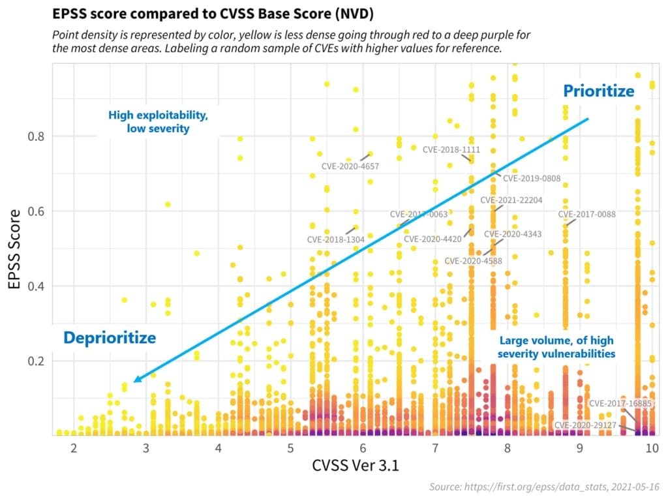

Slide 14

WHAT IS EPSS?
Exploit Prediction Scoring System is a data-driven approach to assessing the likelihood of a software vulnerability being exploited. By leveraging data from past exploits, threat intelligence feeds, and system configurations, EPSS calculates a comprehensive score indicating the probability of an exploit occurring.

Slide 15
HOW DOES THIS HELP?
PRIORITISING
ESTIMATING
Prioritize vulnerability remediation efforts and focus on the most pressing threats.
Probability of an attack happening in the coming 30 days or so.

Slide 16
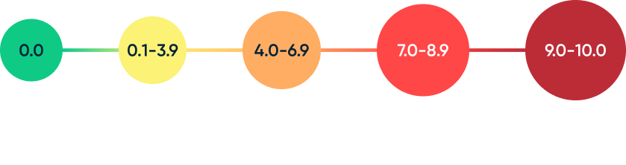
WHAT IS CVSS?
Common Vulnerability Scoring System for assessing the severity of cybersecurity vulnerabilities. It offers a structured framework that considers various aspects of a vulnerability impact and exploitability to generate a numerical score.

Slide 17
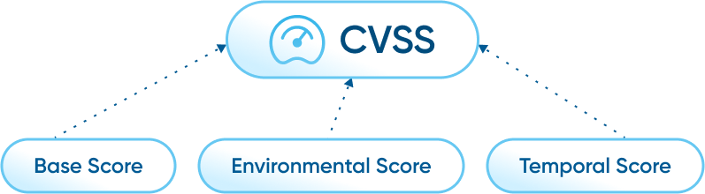
SCORE FACTORS

Slide 18
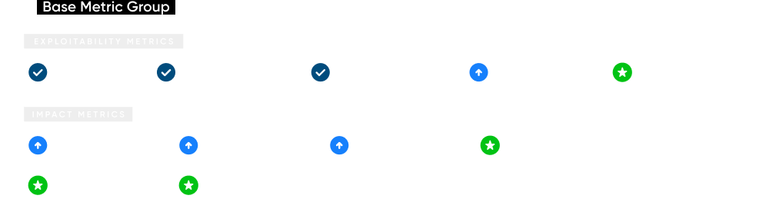

CVSS 4.0: WHAT’S NEW?

Slide 19
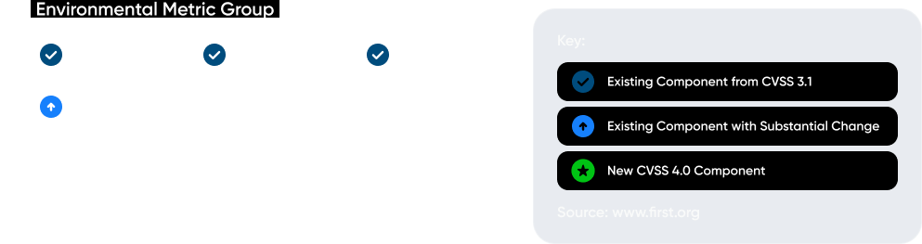
CVSS 4.0: WHAT’S NEW?

Slide 20
THANK YOU
And welcome to the future of privacy :)

